Slide 1

Institute of Engineering & Technology

Slide 2
PROJECT: CARA (E-COMMERCE WEBSITE)
Presented by:
201500003 AASHI MEHROTRA
201500187 AYUSHI GUPTA

Slide 3
CONTENTS
WHAT IS E-COMMERCE
WHY USE E-COMMERCE
INTRODUCTION
OBJECTIVE
SCOPE
MODULE
ADVANTAGES AND DISADVANTAGES
TECHNOLOGIES USED
FRONT END FOLDER
DFD
SCREENSHOTS
CONCLUSION
FUTURE REFERENCES

Slide 4
What is E-Commerce?
Commonly known as Electronic Marketing.
It consist of buying and selling goods and services over an electronic systems Such as the internet and other computer network."
E-commerce is the purhasing, selling, and exchanging goods and services over computer networks through which transaction or terms of sale are performed Electronically.

Slide 5
Why Use E-Commerce?
LOW ENTRY COST
REDUCES TRANSACTION COSTS
ACCESS TO THE GLOBAL MARKET
SECURE MARKET SHARE

Slide 6
INTRODUCTION
The purpose of this project is that company can sell their product online and earn cash.
E-commerce is the buying and selling of goods and services or the transmitting of funds or data, over an electronic network, primarily the Internet.

Slide 7
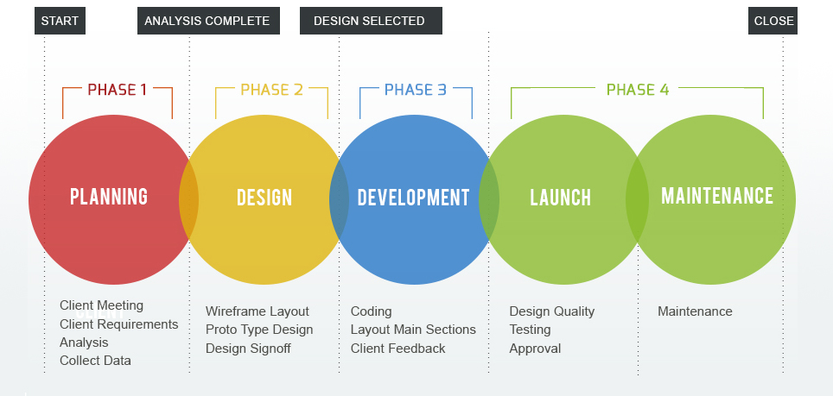

Slide 8
OBJECTIVE
Our goal is to make this website the best E-commerce website in India to sell high quality products directly to the public at amazing pries! Bringing supplements from around the world to you. Discover cara.com website stats, rating, details, and status online

Slide 9
SCOPE
Electronic Commerce is more than just buying and selling products online.It also includes the entire online process of developing ,marketing, selling, delivering, servicing and paying for product and services.

Slide 10
MODULE
HOME
SHOP
BLOG
ABOUT US
CONTACT
CART
LOGIN

Slide 11
ADVANTAGES OF E-COMMERCE WEBSITE
A LARGE MARKET
LOWER COST
MORE OPPORUTINITIES FOR SELLING
PERSONALIZED MESSAGING
CUSTOMER INSIGHTS VIA TRACKING AND ANALTYTICS
COST REDUCTION
FASTER BUYING PROCESS

Slide 12
DISADVANTAGES OF E-COMMERCE WEBSITE
LACK OF PERSONAL TOUCH
CREDIT CARD FRAUD
ID SECURITY ISSUES
PERSONALIZED MESSAGING
NEED FOR INTERNET ACCESS
PRICE AND PRODUCT COMPARSION

Slide 13
TECHNOLOGY USED
LANGUAGES USED
HTML
CSS
JAVASCRIPT
TOOL USED
VISUAL STUDIO CODE

Slide 14
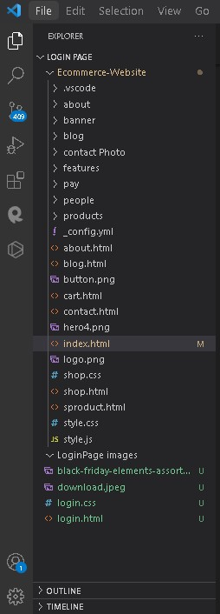
Front-End Folder

Slide 15
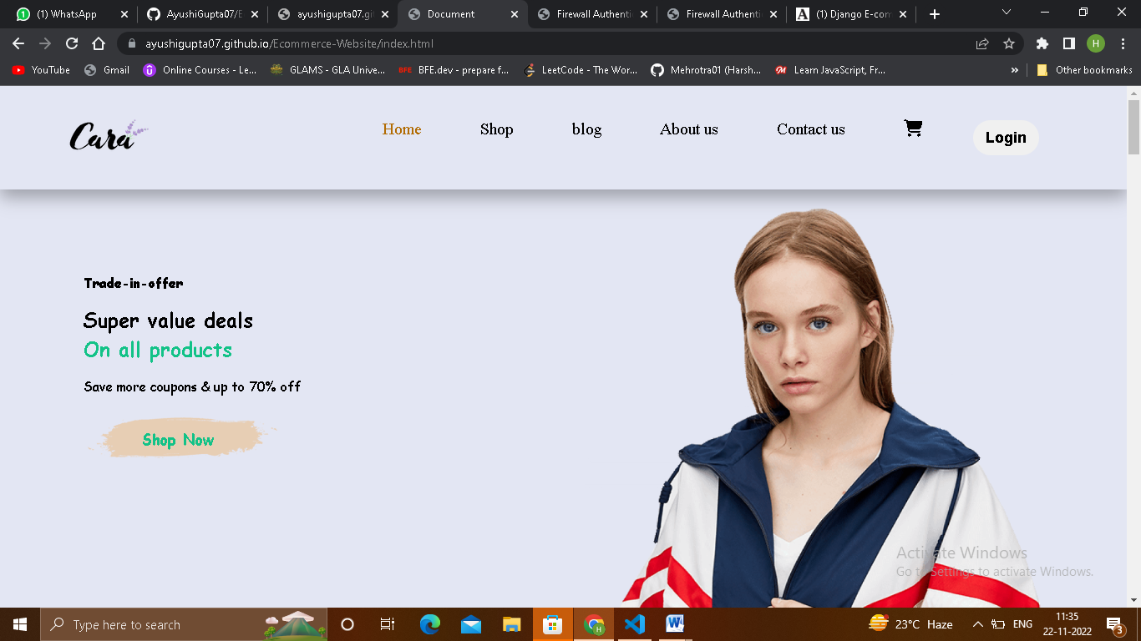

Slide 16
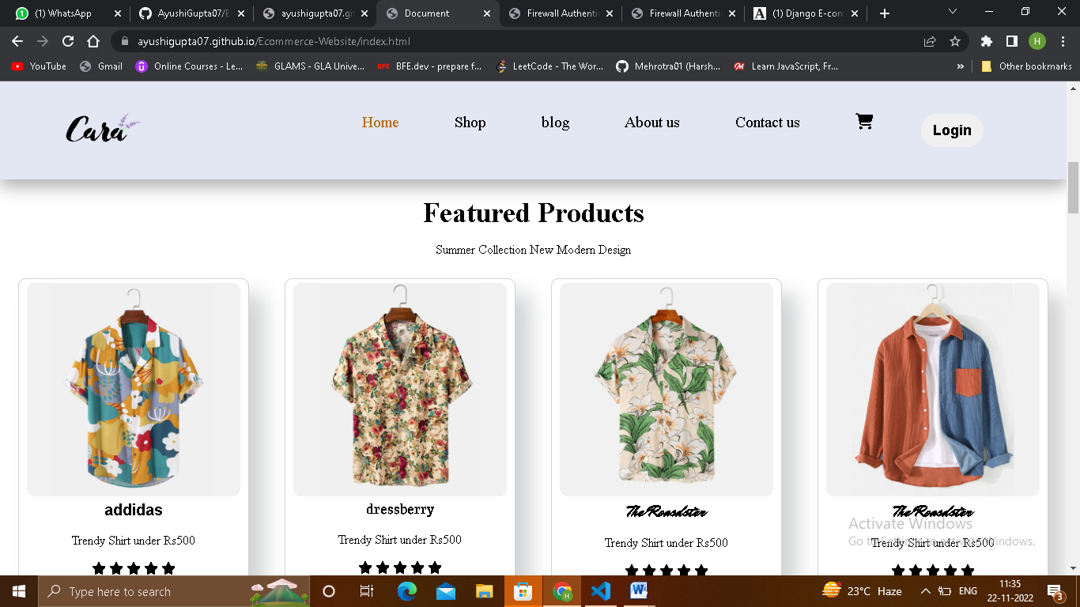

Slide 17
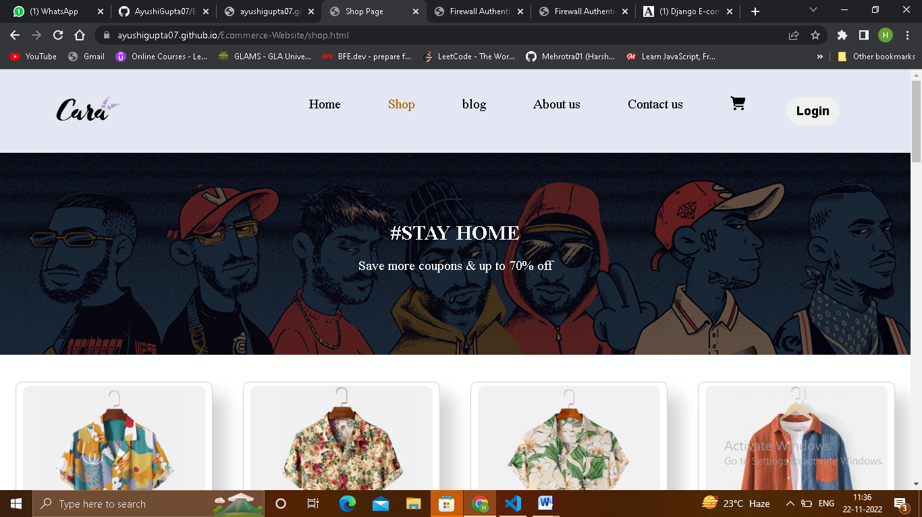
SHOP PAGE

Slide 18
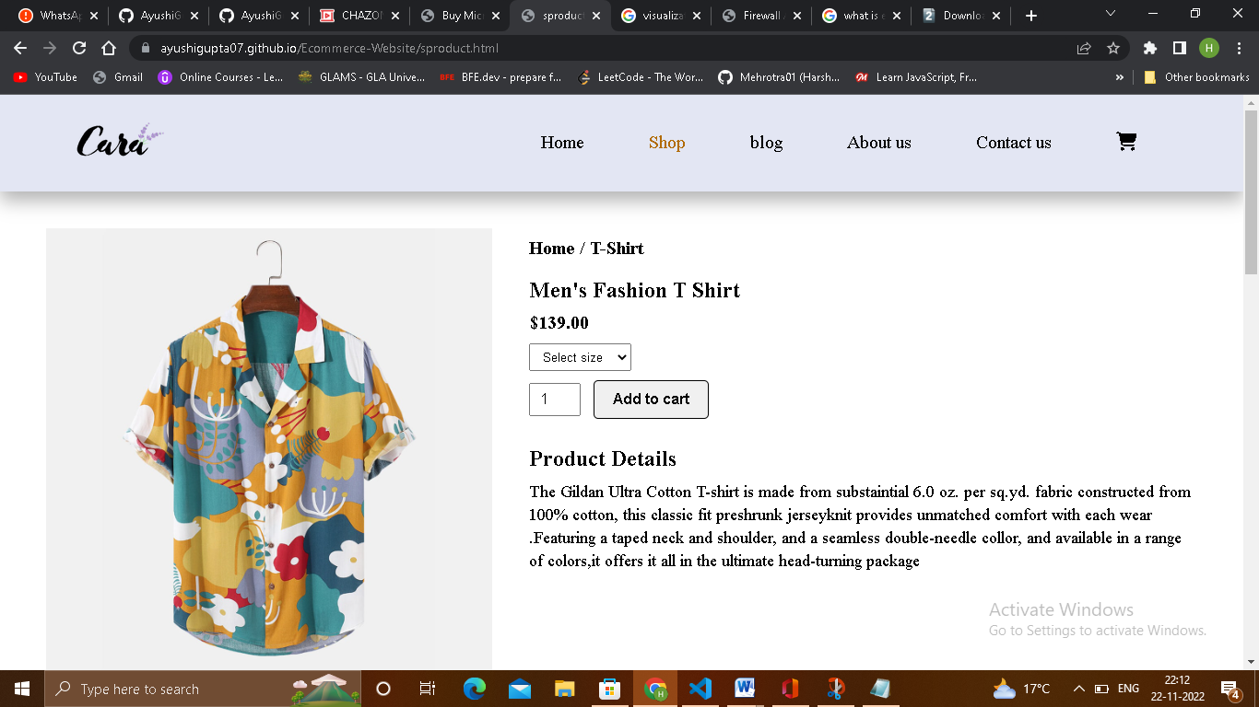
SHOP PAGE

Slide 19
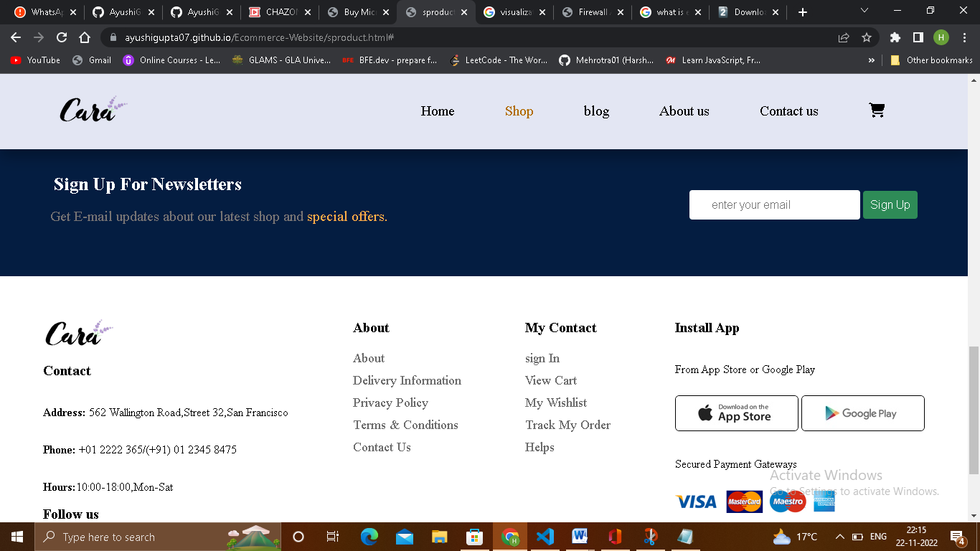
FOOTER

Slide 20
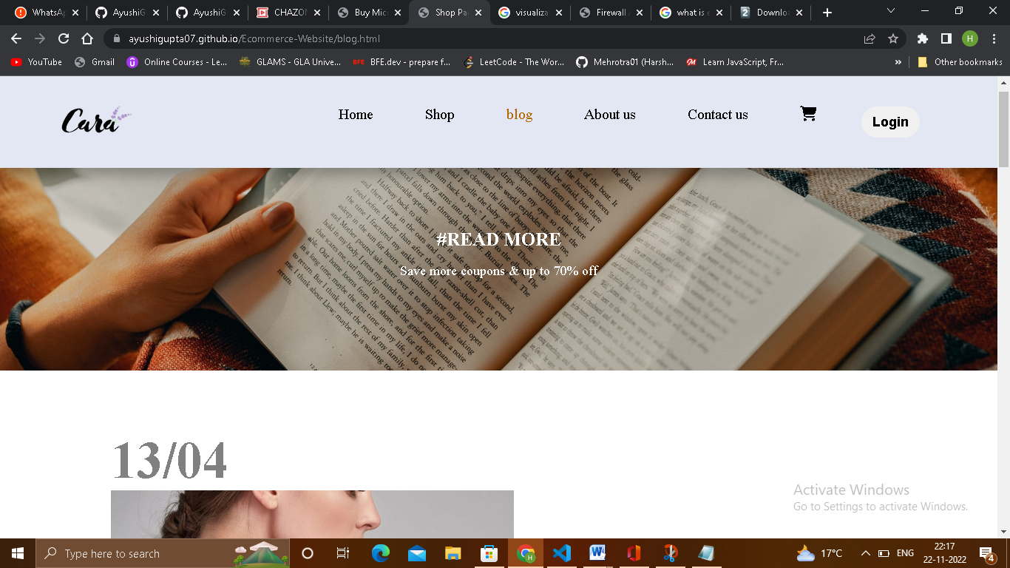
BLOG PAGE

Slide 21
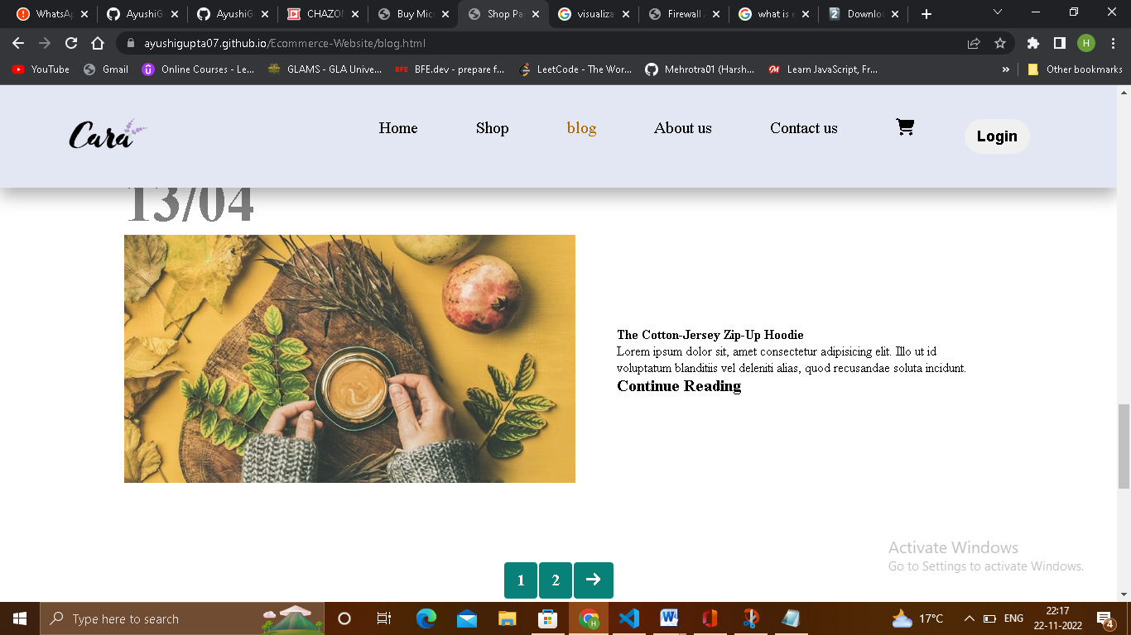
BLOG PAGE

Slide 22
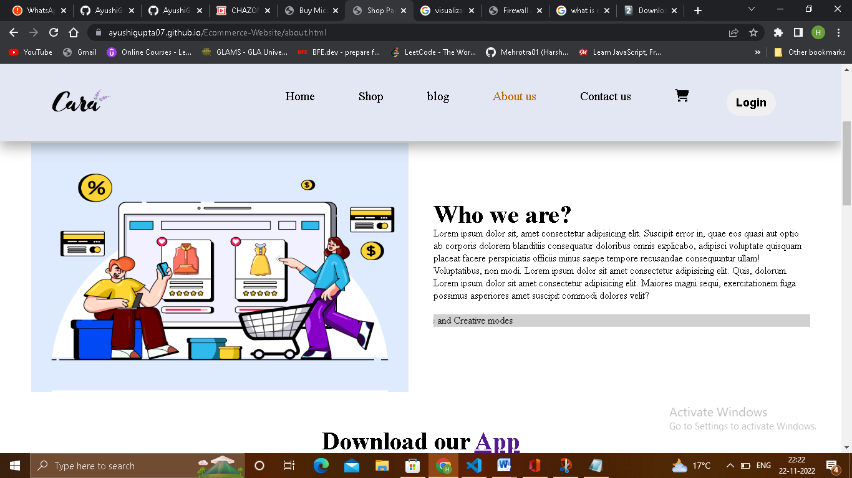
ABOUT US PAGE

Slide 23
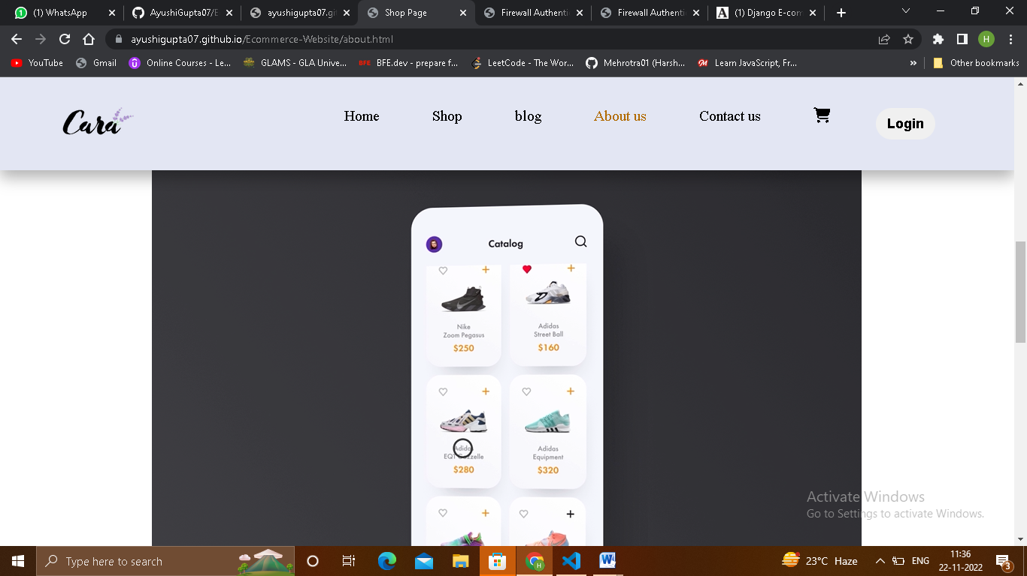
ABOUT US PAGE

Slide 24
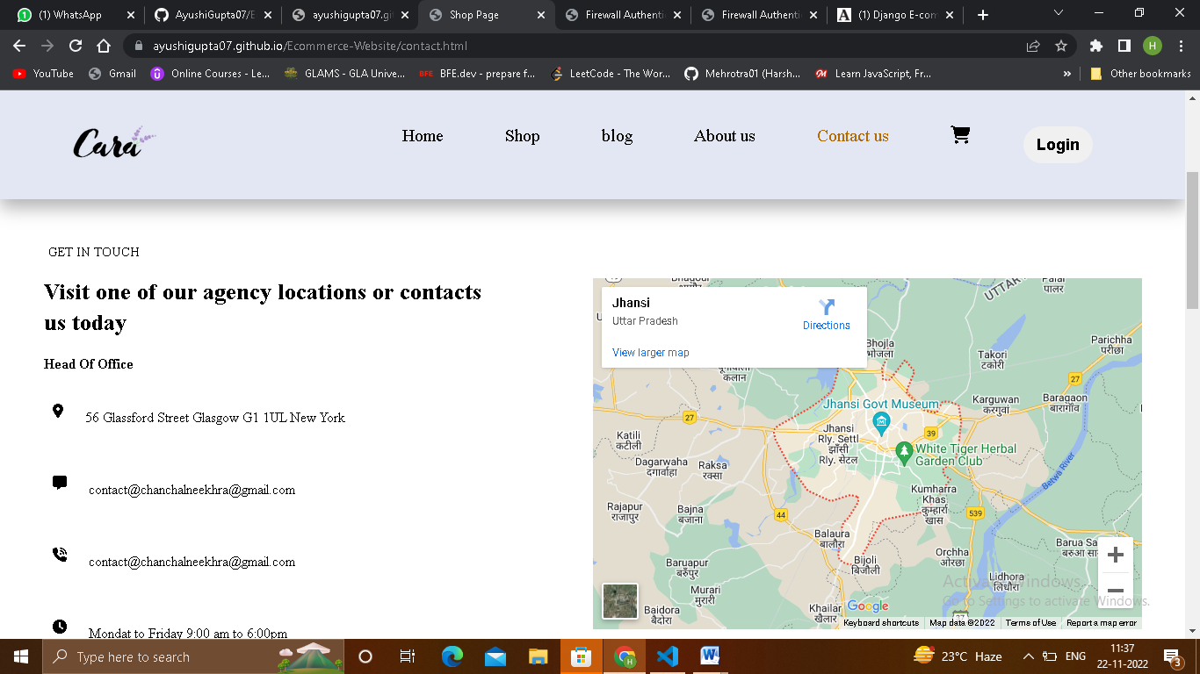
CONTACT US PAGE

Slide 25
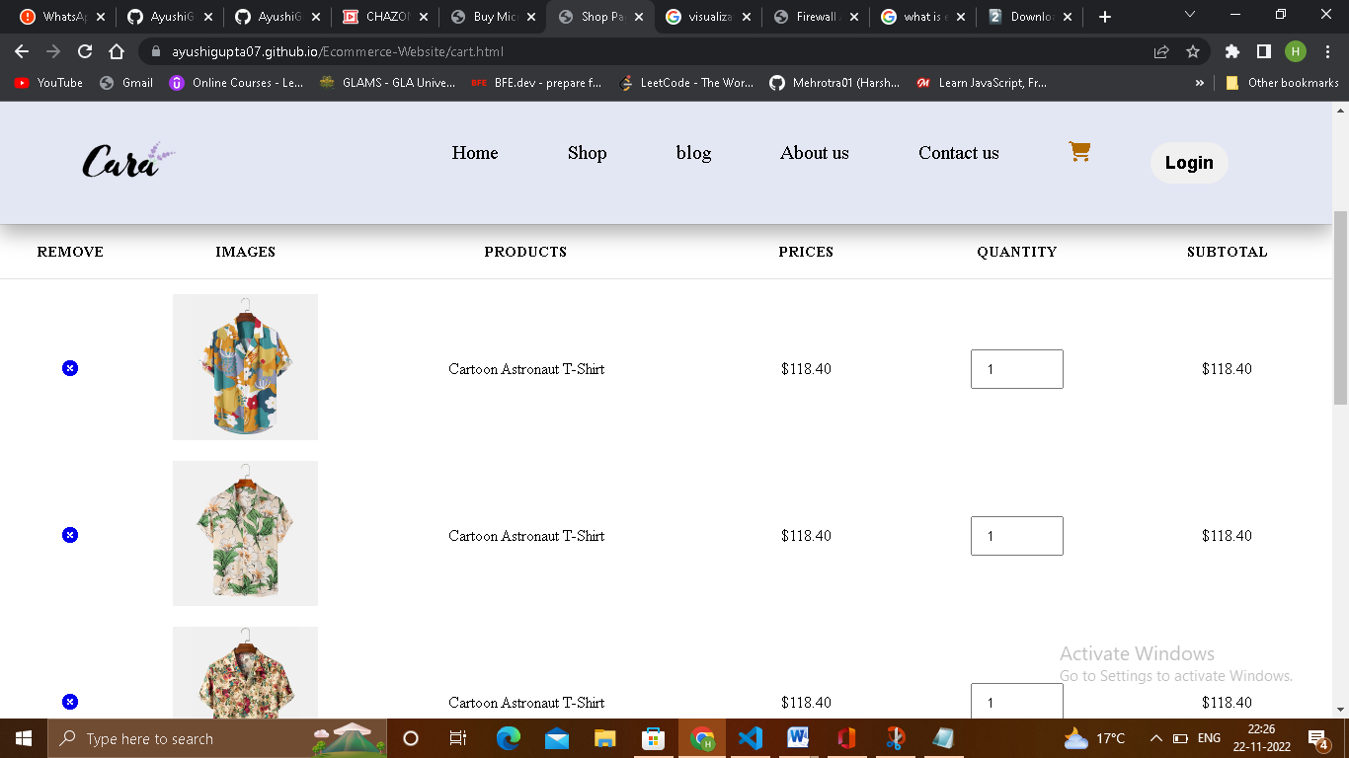
CART PAGE

Slide 26
CART PAGE

Slide 27
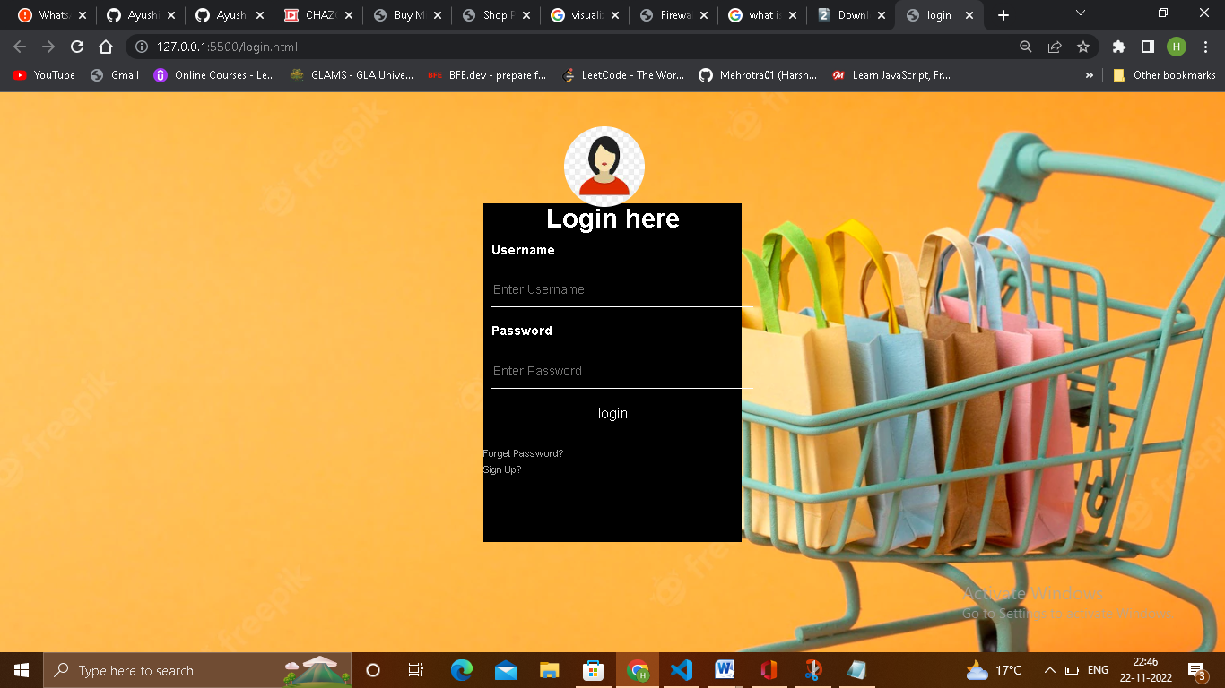
LOGIN PAGE

Slide 28
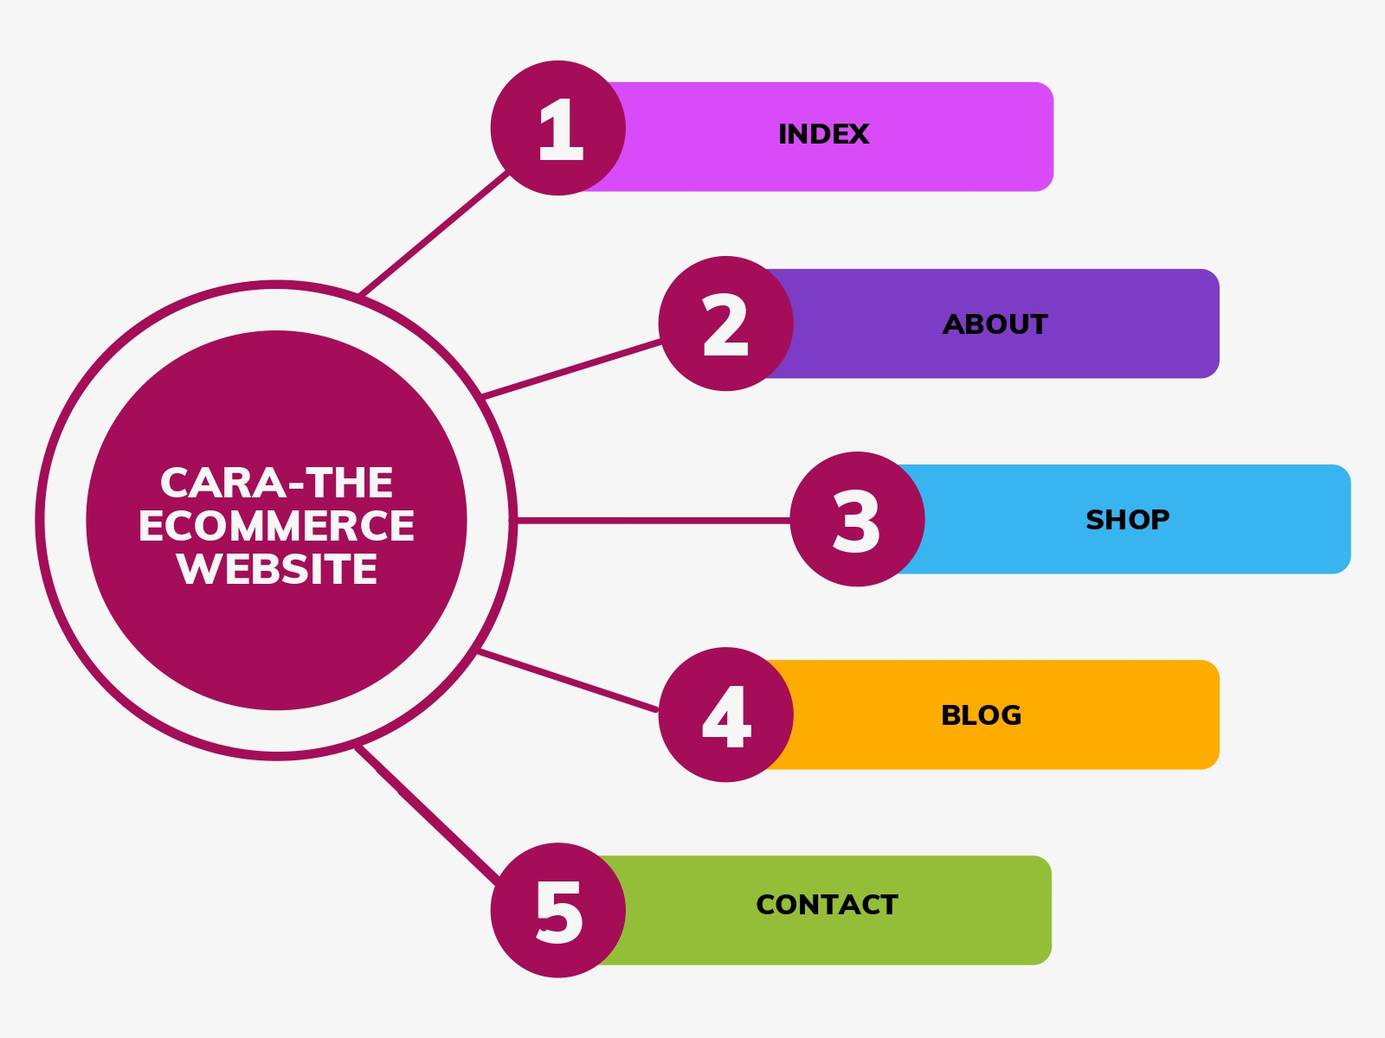
FLOWCHART

Slide 29
CONCLUSION
The project entitled Online shopping system was completed successfully. The system has been developed with much care and free of errors and at the same time it is efficient and less time consuming. The purpose of this project was to develop a web application and an android application for purchasing items .
This project helped us in gaining valuable information and practical knowledge on several topics like designing web pages using html ,css and javascript usage of responsive templates, designing of android application . The entire system is secured. Also the project helped us understanding about the development phases of a project

Slide 30
THANK YOU

